Slide 1


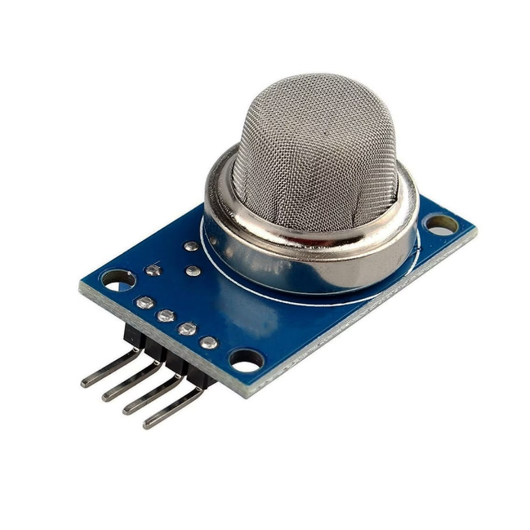


Introduction to MQ-135 Gas Leakage Sensor
The MQ-135 gas sensor is a highly sensitive and versatile device designed for detecting various gases in the air, including methane, ethanol, propane, and butane. It is widely used in industrial and household applications for gas leakage detection, air quality monitoring, and safety systems.
by Swaraj kumar

Slide 2

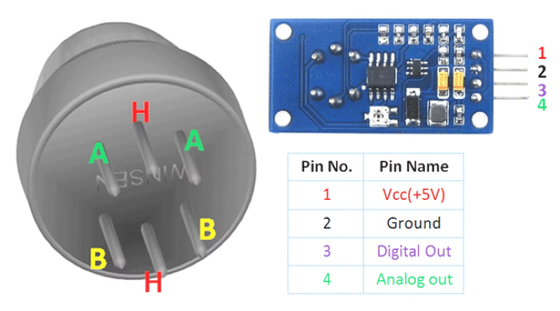
Principle of Operation
The MQ-135 operates on the principle of metal oxide semiconductor (MOS) gas sensing technology. It utilizes a sensitive sensing element made of tin dioxide (SnO2) that changes its electrical resistance when exposed to target gases. The sensor's resistance varies depending on the concentration of the gas, enabling it to detect and quantify the presence of specific gases.
1
Gas Adsorption
2
Resistance Change
When target gas molecules come into contact with the SnO2 sensing element, they are adsorbed onto its surface.
The adsorption of gas molecules alters the electrical conductivity of the SnO2, causing a change in resistance.
3
Signal Output
The sensor converts the resistance change into an electrical signal, which is then processed and interpreted to determine the concentration of the target gas.

Slide 3
Sensor Components
The MQ-135 gas sensor typically consists of several key components that work together to detect and measure gas concentrations.
Sensing Element
Heater
Protective Cover
The sensing element is the heart of the sensor. It is typically made of tin dioxide (SnO2) material, which is highly sensitive to the presence of various gases.
A heater element is used to maintain the sensing element at an optimal operating temperature, usually around 150-250 degrees Celsius. This ensures that the sensor is sufficiently sensitive to detect target gas molecules.
A protective cover is placed over the sensing element to shield it from environmental factors such as dust and moisture. It also helps to improve the sensor's longevity and reliability.

Slide 4

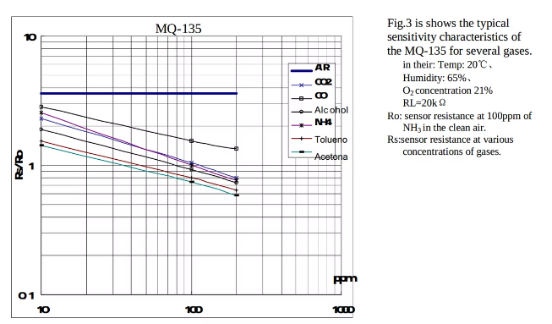
Sensitivity and Detection Range
The sensitivity of the MQ-135 sensor refers to its ability to detect low concentrations of target gases. The detection range indicates the concentration levels that the sensor can accurately measure. The MQ-135 typically exhibits high sensitivity to various gases, with detection ranges ranging from a few parts per million (ppm) to several hundred ppm.
Gas
Sensitivity (ppm)
Detection Range (ppm)
Methane (CH4)
10-50
50-1000
Ethanol (C2H5OH)
5-20
20-500
Propane (C3H8)
20-100
100-2000
Butane (C4H10)
30-150
150-3000

Slide 5

Calibration and Response Time
Calibration is crucial for ensuring accurate and reliable gas detection using the MQ-135 sensor. The calibration process involves adjusting the sensor's output signal to match known gas concentrations. Response time refers to the time taken by the sensor to detect and respond to a change in gas concentration.
1
2
3
Initial Calibration
Response Time
Periodic Recalibration
The MQ-135 sensor is typically calibrated in a controlled environment using a known gas concentration.
The sensor's response time is typically measured in seconds and depends on the concentration and type of gas being detected.
Regular recalibration is recommended to ensure ongoing accuracy and reliability, especially in environments with fluctuating gas levels.

Slide 6

Applications and Use Cases
The MQ-135 gas sensor is a versatile device with a wide range of applications in various industries and settings, primarily for gas leakage detection, air quality monitoring, and safety systems.
Gas Leak Detection
Air Quality Monitoring
Safety Systems
In homes, industries, and laboratories, the MQ-135 is used to detect gas leaks from appliances, pipelines, and other sources, alerting users to potential hazards.
The sensor can be used in air quality monitoring systems to detect and quantify harmful gases, such as carbon monoxide and volatile organic compounds, providing insights into indoor and outdoor air quality.
The MQ-135 is incorporated into safety systems, including fire alarms, gas detectors, and industrial safety equipment, to trigger alarms or activate safety measures in case of gas leaks or hazardous conditions.

Slide 7

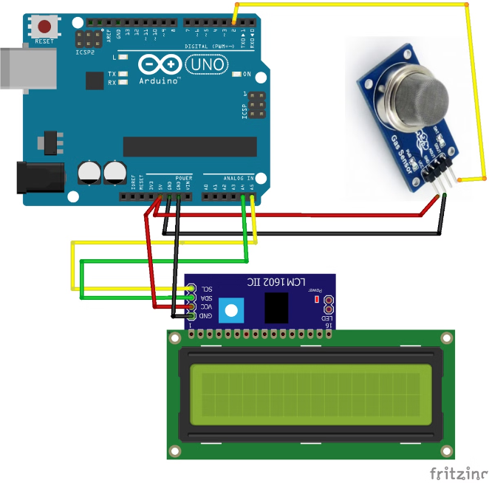



Installation and Integration
Installing and integrating the MQ-135 gas sensor requires careful consideration of the application's specific requirements and environmental factors. It typically involves mounting the sensor in a suitable location, providing power supply, and connecting it to a processing unit or controller.
Mounting
The sensor should be mounted in a location that provides adequate airflow and minimizes interference from other sources.
Power Supply
The sensor requires a stable power supply, typically 5 volts DC, to operate correctly. The power supply should be properly connected to the sensor's terminals.
Signal Conditioning
The sensor's output signal may need to be amplified or filtered depending on the application and the processing unit's requirements.

Slide 8

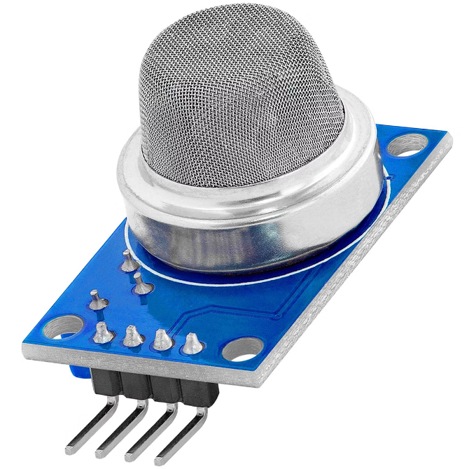



Maintenance and Troubleshooting
To ensure long-term performance and reliability, the MQ-135 sensor requires regular maintenance and troubleshooting. This involves cleaning the sensor element, checking for signs of damage or wear, and addressing any performance issues that may arise.
Regular Cleaning
The sensing element should be cleaned regularly to remove dust and debris that can affect its sensitivity.
Troubleshooting
If the sensor exhibits abnormal readings or fails to detect gases, troubleshooting steps should be taken to identify and address the issue.
Replacement
Over time, the MQ-135 sensor's sensitivity may degrade, and it may require replacement to maintain accurate gas detection.

